Slide 1
paymob Surveying System
Hazem gamal elgendy
Omar ahmed Mansour
Mentored by:
Eng. Mostafa aboghazay
Eng. Mostafa gomaa

Slide 2
The Problem
What is the problem?
Launching surveys to employees
Who has this problem?
People in managerial positions
Why should this problem be solved?
Make employee’s assessments easier
How would you solve this problem ?
Creating website and an api for added flexibility

Slide 3
Background Information
Many companies still suffer from handling paper surveys.
Disadvantages of using paper-based surveying system
Very slow process
Managing this type o f surveys may turn out to be a hassle
Searching for papers is a headache
Paper may be lost easily

Slide 4
Workable Solutions
Solution #1
Using generic google forms.
Pros:
Cons:
ease of use
Free
Not very flexible
Privacy
Solution #2
Our web-based system
Pros:
Flexibility
API can be used to make solutions in different environment
More suited to companies
Cons:
Extra effort and money.

Slide 5
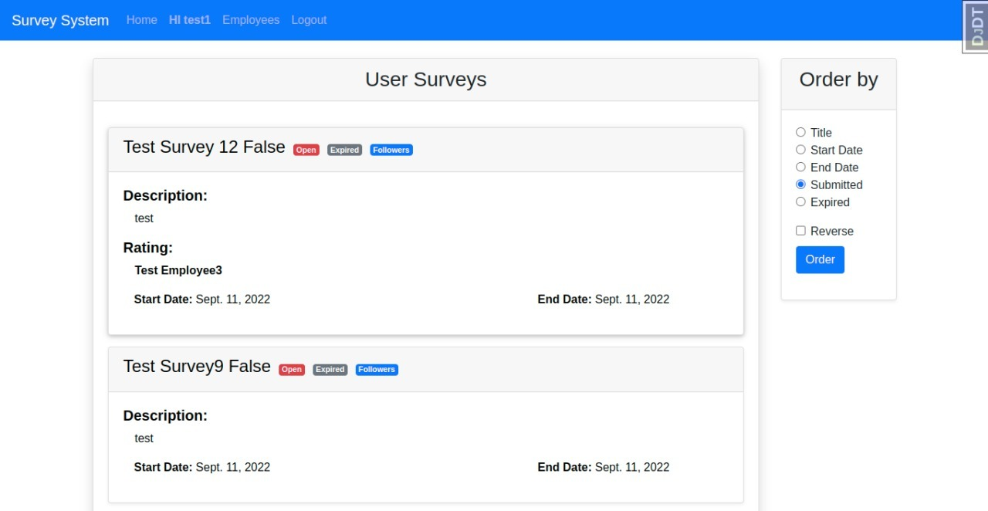
The Prototype
<Insert a picture or drawing of your prototype here>

Slide 6
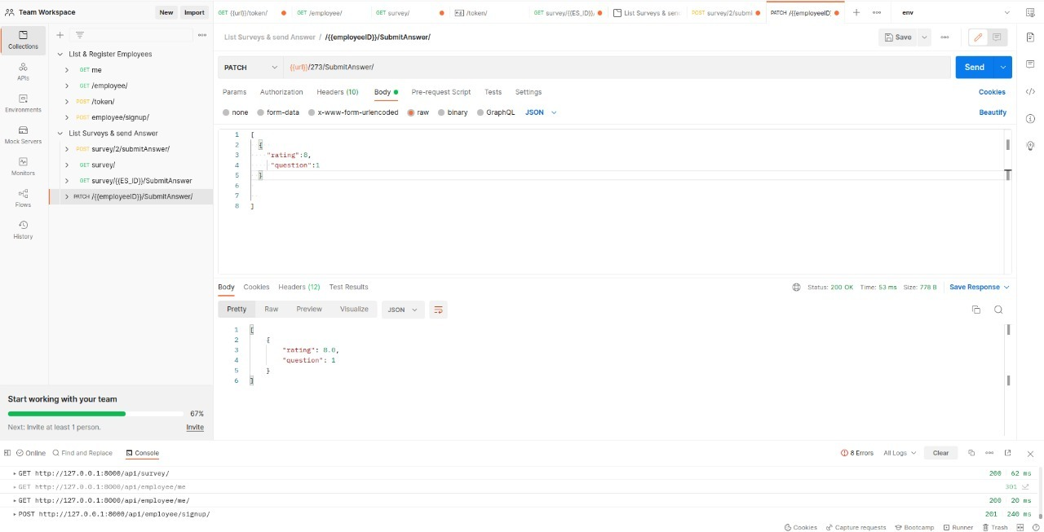
POSTman collections

Slide 7
actors
Admin
Has the ability to create and launch surveys
Responsible for employee's hierarchy
Employee
Self-registration
Able to participate and submit surveys

Slide 8
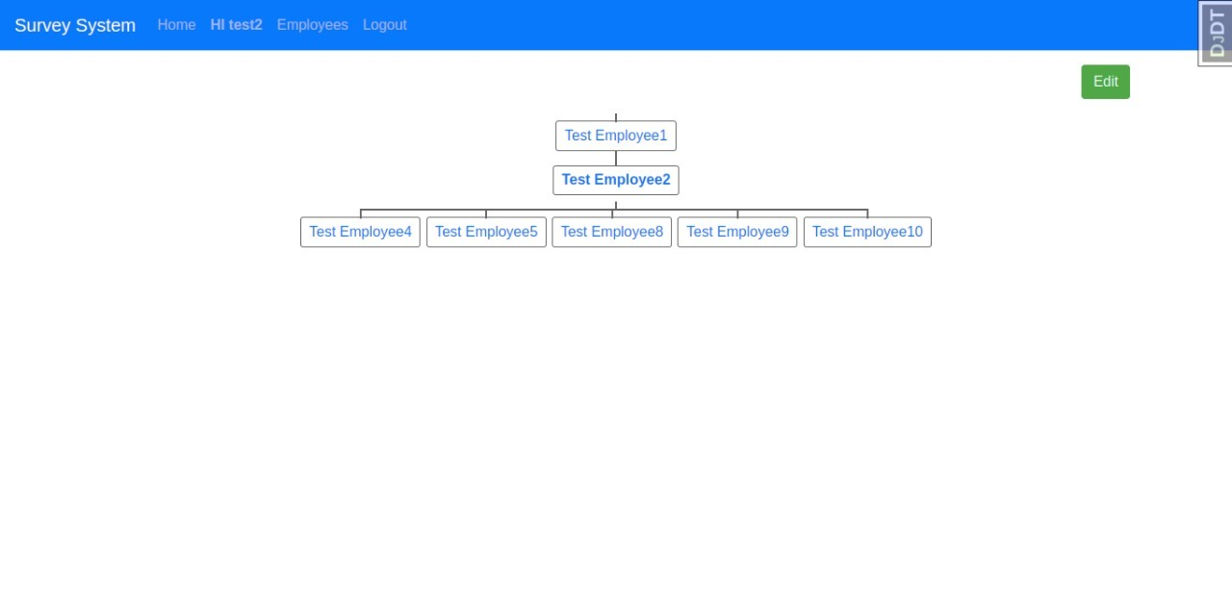
Single Employee hierarchy

Slide 9
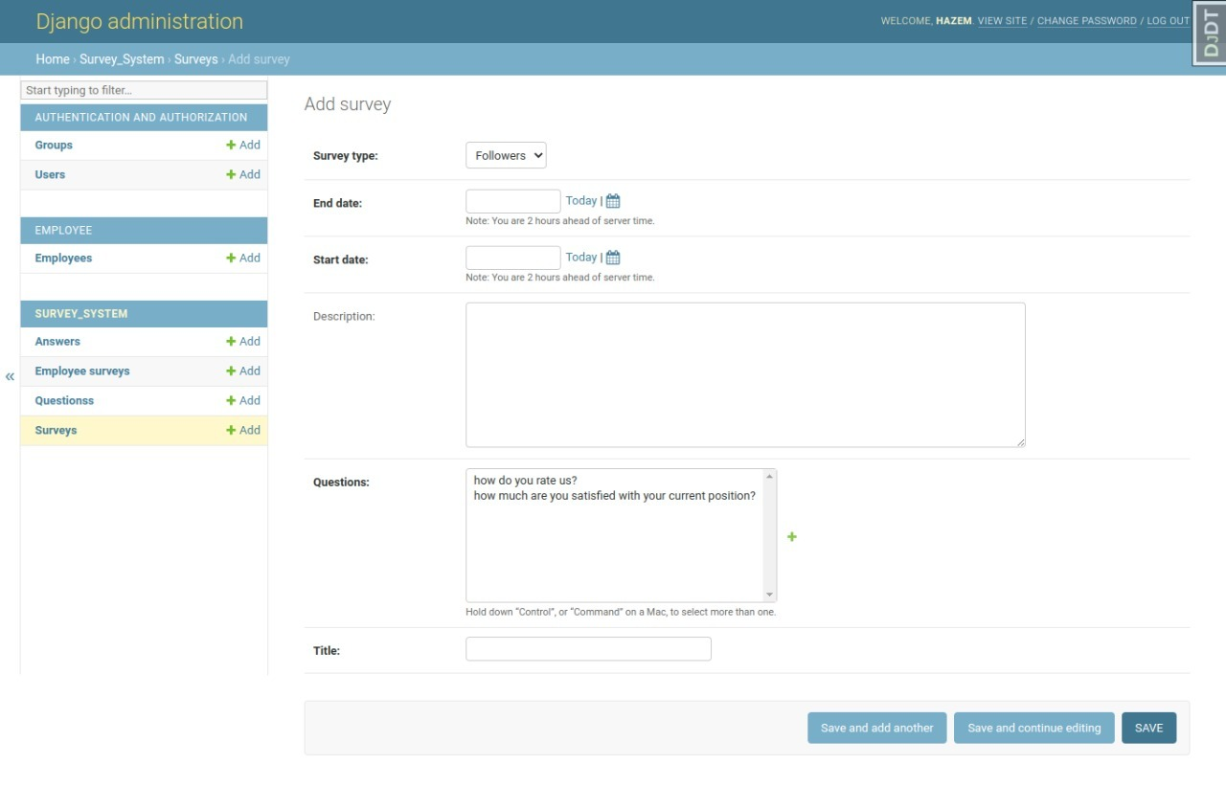
Admin site

Slide 10
Thank you

